Slide 1
What you need to know about NCEA

Slide 2
NCEA PRESENTATION
Where to get information
What is NCEA Level 1,2,3
What and How do you gain University Entrance
Academic Honours (SMC)
Extension of Assessment Date Process
Appeals Process
Resubmission Process
Further Information

Slide 3
Where can I go to help my child with their NCEA Journey?
Sancta Maria College Teachers (contact information can be found in the school website)
My Childs Schoology Page
NZQA Website
NCEA Student Handbook
Principals Nominee - Anita Heffernan
StudyTime – Youtube Videos -https://www.youtube.com/user/studytimenz/videos

Slide 4
Outstanding Results
The highest NCEA achieving school in East Auckland.
In the Top 10 best NCEA performing schools in the whole of Auckland.
Academic Year | NCEA LEVEL 1 | NCEA LEVEL 2 | NCEA LEVEL 3 | University Entrance
2021 | 96.2% | 97.9% | 99.2% | 94.3%
To see how well a school has achieved in NCEA,
go to Secondary School Statistics on the NZQA website.

Slide 5
NCEA National Certificate of Educational Achievement
Level 1 / Level 2 / Level 3 + Scholarship (external examination)
Subjects are divided up into groups of Achievement Standards (topics) for assessment throughout the year, each worth a particular number of credits.
Standards are assessed either internally (majority) or externally (exams).
Possible grades: Achieved, Merit , Excellence and Not Achieved

Slide 6
NCEA National Certificate of Educational Achievement
Depending on the difficulty of the standard, each one is allocated a number of credits, usually between 2-5.
A year course in a subject is usually worth a total of between 16 to 18 credits x 6 courses (Total opportunity of Credits 96-108 per year)
The focus is on the quality of the credits – Merit and Excellence, rather than the final credit total.
Why?

Slide 7
NCEA National Certificate of Educational Achievement
Level 3 – Year 13
80 credits
at level 3
Level 2 – Year 12
80 credits
at level 2
Level 1 – Year 11
80 credits
at level 1 or above
Or:
60 credits
at Level 3 or above plus 20 credits at level 2 or above
Or:
60 credits
at Level 2 or above plus 20 credits at any level
Including:
10 literacy credits
10 numeracy credits

Slide 8
University Entrance Qualification
NCEA Level 3 qualification is required (60 Level 3 credits)
14 credits at Level 3 from 3 approved subjects – Total 42 Credits
UE Literacy at Level 2 with 10 Credits, available from a variety of subjects 5 credits in reading and 5 credits in writing
UE Numeracy at level 1 with 10 credits or higher

Slide 9
Why do I want my child to achieve Merit’s and Excellence?
WHAT DO I NEED TO GO TO UNIVERSITY
Some degrees have harder entrance requirements and calculate entrance on students Level 3 best 80 credit
Guaranteed Entry Score - Auckland University
280 = Biomedical Science, 260 = Engineering
CALCULATING MY RANK SCORE: How your NCEA rank score is calculated
Your rank score is based on your best 80 credits at Level 3 or higher over a maximum of five approved subjects.
These credits are then weighted by awarding points based on the level of achievement
Excellence (4 points), Merit (3 points) or Achieved (2 points)
attained in each set of credits.

Slide 10
Sancta Maria College Academic Honours
NCEA Level 1
Academic Honours Gold | 50 credits at Excellence
Academic Honours Silver | 50 credits at Merit and/or Excellence
NCEA Level 2
Academic Honours Gold | 50 credits at Excellence
Academic Honours Silver | 50 credits at Merit and/or Excellence
NCEA Level 3
Academic Honours Gold | 50 credits at Excellence
Academic Honours Silver | 50 credits at Merit and/or Excellence

Slide 11
Scholars Badge Sancta Maria College Academic Honours
NCEA Level 1 Scholars Badge | A student will receive Scholarship Endorsement for a course if they achieve 14 or more credits at Excellence in a single year. 3 of these credits must be from externally assessed standards. 3 of these credits must be from internally assessed standards.
NCEA Level 2 Scholars Badge
NCEA Level 3 Scholars Badge

Slide 12
FAQ: 1. What if I’m sick when an assessment is on? 2. What if there has been an accident or emergency when an assessment is on?
STEP PROCESS
Email the Principals Nominee and your teacher immediately.
Get doctor to provide medical certificate or letter from guardian.
Complete the Application for Change of Assessment Date (Late, Extension, Missed Assessment)
Give the completed form to your Teacher who will rearrange another date for the assessment to take place on

Slide 13
FAQ: 3. What if I need to apply for an extension to a deadline?
Complete the Application for Change of Assessment Date (Late, Extension, Missed Assessment)
Give the completed form to your Teacher who will rearrange another date for the assessment to take place on
The PN may grant an extension, set a new date, or decline the application.

Slide 14
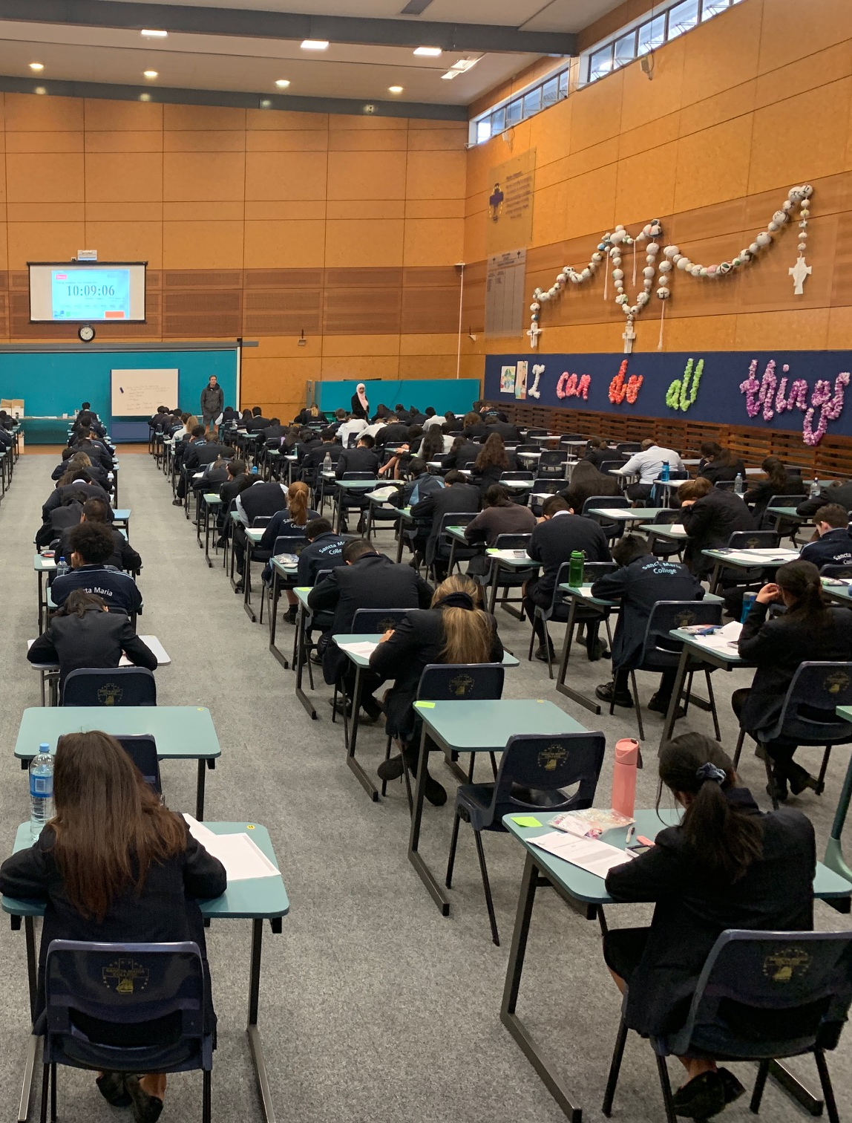
All work must be your own.
All work that you submit for assessment must be your own.
Sancta Maria College uses TURNITIN
Handing in work that has not been done by you and claiming that it is so, is cheating. Cheating can involve for example; copying another student’s work, copying from a book and not acknowledging that it is not your own work, getting undue help from someone else, or taking banned materials into an assessment.
Authenticity is essential.
You will be asked to sign a document that the work you are handing in is entirely your own.
Departments may also ask you to provide draft copies, complete tasks in class, reference accurately all sources of information or other methods to prove authenticity.

Slide 15
The Appeals Process This process may be used if you disagree with any decision relating to assessment. https://www.sanctamaria.school.nz/wp-content/uploads/2019/09/SMC_NCEA_Assessment_Appeal_Application_Form.pdf
A grade is warded.
Teacher will explain criteria.
You can ask the teacher to reconsider your work.
Teacher explains results and makes any necessary alterations.
They may decide to alter your grade at this point, or not.
Still unhappy with the result…
The decision of the Principal’s Nominee is final.
Apply for an appeal. Use the Appeals Application Form.

Slide 16
Further Assessment Opportunity (FAO)
A Further Assessment Opportunity is when your teacher offers you another chance to achieve a standard when you have initially failed to achieve to your potential – you must be able to improve your original grade.
Resubmission (Resub)
Schools may offer a resubmission opportunity to students only when a minor error prevents them from reaching an ‘Achieved’ grade.
The only change in grade boundary available for resubmissions is from ‘Not Achieved’ to ‘Achieved.’
On this basis, the highest grade that can be awarded as a result of a resubmission of an internal assessment is limited to ‘Achieved’.

Slide 17
There is always work to be done!
How much do you really know about your child’s learning?
There is no such thing as “no homework” at Senior levels. Your child will always have work to do. – For due dates look at course outlines
Laptops are essential
Assessments are now happening all through the year not just in November.

Slide 18
Do you know what happens behind closed doors?
Monitor Phone Use: Social media focus? Computer games? Watching YouTube and videos? Procrastination?
Research is now showing sleep deprivation amongst young people is a real issue, in this 24/7 technological world.
Turn off your Wi-Fi / Data at home.
Do you have a rule at home about phones and gadgets being turned off at bedtime?
Are they allowed their devices in their bedrooms when they go to bed??

Slide 19
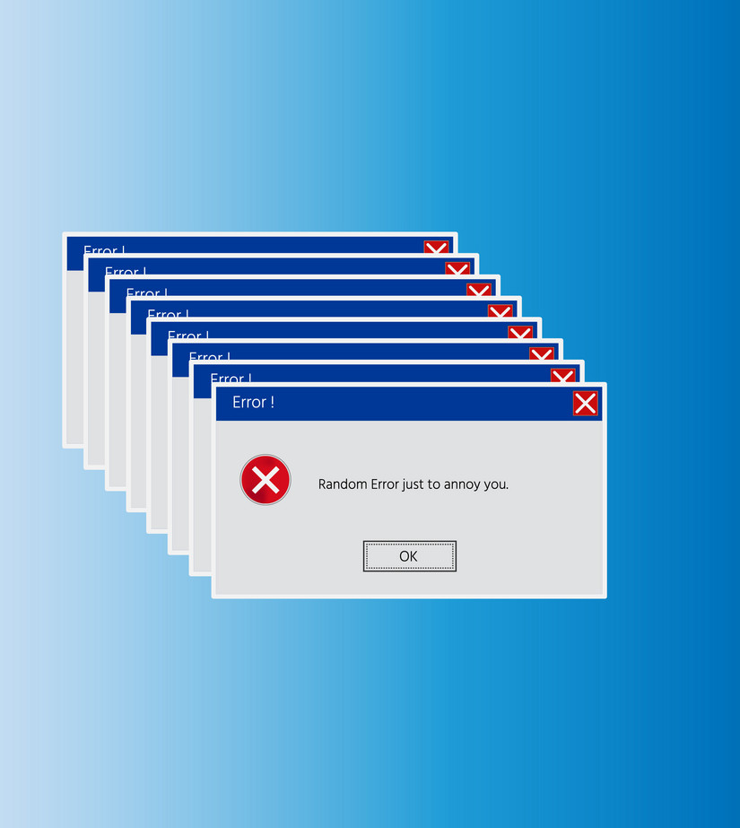
Back it up!
Back up Student Work
Use your Hard Drive, OneDrive (Office 365,GoogleDrive) or the School network. USB’s can be faulty.

Slide 20
Any more questions?
Anita Heffernan | Principal’s Nominee
Chris Sullivan | Head of Senior School
Andrew Ardern | Year 13 Dean
Ryan Camp | Year 11 Dean
Makayla Samaeli | Year 11 Dean
Louise Oliphant | Head of Learning Support (SACS)

Slide 21
Thank you!

